Slide 1

Lending Club Predictive Modeling Project
Bachir Harb
Data Scientist

Slide 2
Agenda
Problem Statement
How Lending Club works
Business Perspective
Exploration Data Analysis
Project Pipeline
Model Valuation
Demonstration
LENDING CLUB
PREDICTIVE MODELING

Slide 3



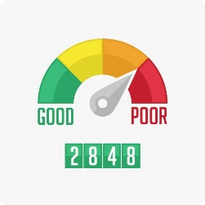
Lending Club is the world’s largest peer-to-peer marketplace connecting borrowers and investors.
Since its inception in 2007, the number of loans in the marketplace has increased exponentially and the borrowers default on their loans.
A loan status is either good/bad so that the company can approve/decline the new loan applications based on historical loan information.
Problem
Statement
LENDING CLUB
PREDICTIVE MODELING

Slide 4

Borrowers apply for Loans
Investor Open an account
Borrowers get funded
Investors build portfolio
Borrowers repay automatically
Investor earn & reinvest
How Lending
Club work
Typically, investors pay Lending Club a service fee equal to approximately 1% of the
amount of each borrower payment received within 15 days of the payment due date
If borrowers miss a payment, investors do not pay a service fee.
Origination fee from the borrower ; range from 1% to 6% , average is 5.2%
Lending Club’s interest rates take into account credit risk and market conditions
Loan grade is the result of a formula that takes into account not only credit score, but also a combination of several indicators of credit risk.
Grade increment from A1 to G5 , An A loan has an interest rate as low as 6.16 %, a G loan has an interest rate as high as 35.89 %
LENDING CLUB
PREDICTIVE MODELING

Slide 5
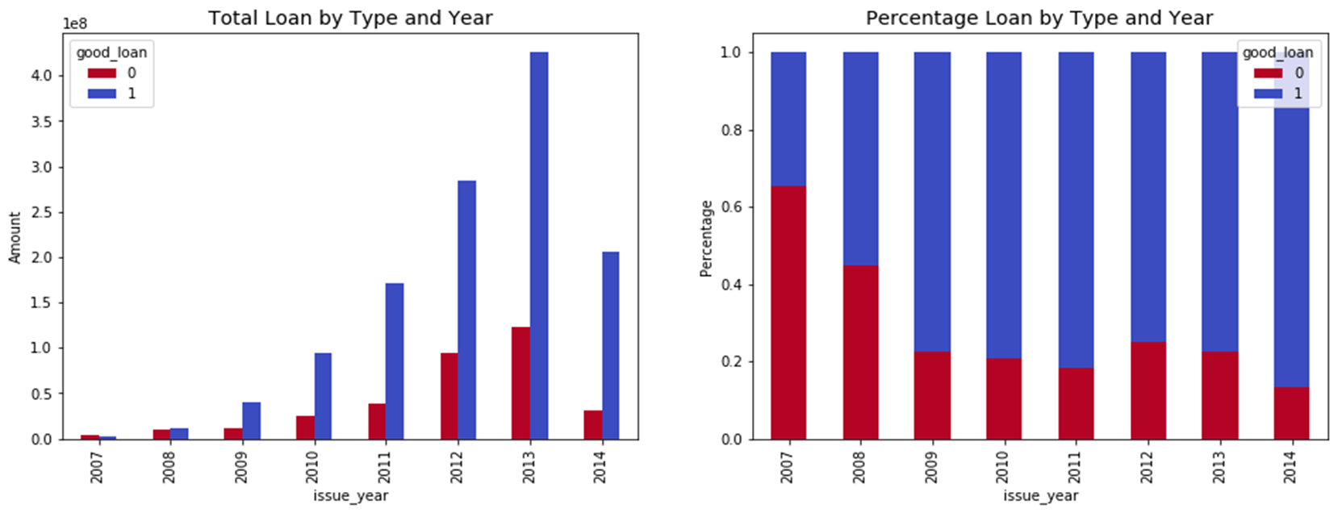

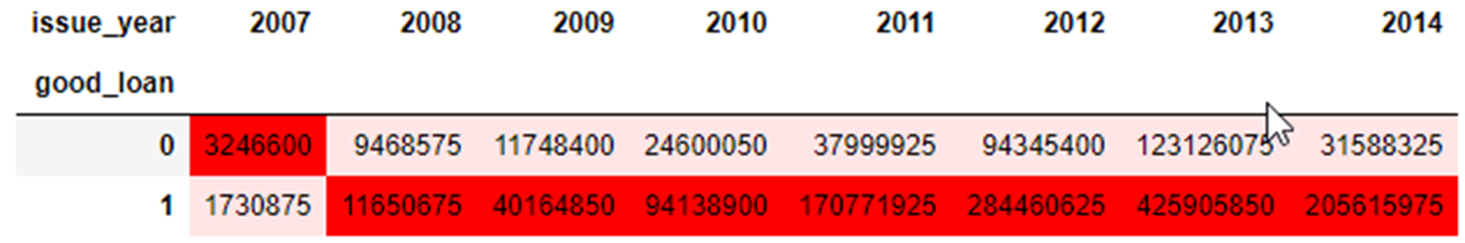
Business
Perspective
7,387,564 USD
1,895,299
USD
LENDING CLUB
PREDICTIVE MODELING

Slide 6
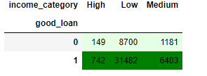
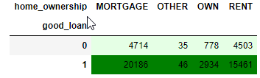
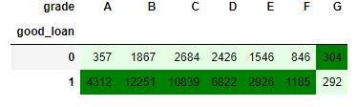

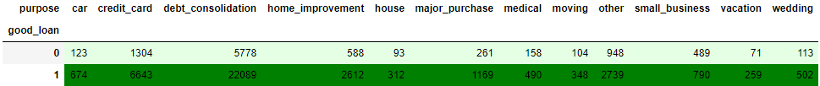
Exploring Data Analysis
How is Loan is distributed
LENDING CLUB
PREDICTIVE MODELING

Slide 7
122607 row
68 Columns
Linear Regression
decision Trees
Random Forest
Project
Pipeline
GUI
For Features Entry and invoking model for Prediction
Data Cleaning
&
Features selection
Model Design
Model Valuation & Parameter Tuning
Model Implementation
Forward Feature Selection
SelectKBest
sklearn.feature_selection
21 Features
Choosing best model using model parameters and parameter tuning
LENDING CLUB
PREDICTIVE MODELING

Slide 8


Model Validation
Decision Tree Gini
Logistic Regression
Accuracy: 0.95 Precision : 0.96 AUC: 0.92
Accuracy: 0.96 Precision : 0.96 AUC: 0.93
Decision Tree Entropy
Random Forest
Accuracy: 0.94 Precision : 0.97 AUC: 0.92
Accuracy: 0.98 Precision : 0.98 AUC: 0.96
Random forest is best suitable based on the Accuracy and Precision
LENDING CLUB
PREDICTIVE MODELING

Slide 9
Random Forest
Grade vs more Features
Grade_num,sub_grade_num
Grade_num ,sub_grade_num
19 more Features
Accuracy : 0.78
Precision: 0.78
Recall : 0.99
Area Under Curve: 0.51
Accuracy : 0.98
Precision: 0.98
Recall : 0.99
Area Under Curve: 0.96
Feature
Engineering
Grade and Sub Grade are great for Rate definition, Prediction need more Features
LENDING CLUB
PREDICTIVE MODELING

Slide 10

Model Demonstration
LENDING CLUB
PREDICTIVE MODELING

Slide 11

REFERENCES:
https://www.lendingclub.com/company/about-us
https://ptmoney.com/borrowing-from-lending-club/
https://www.lendingclub.com/loans/resource-center/understanding-credit-scores
Supporting Documents
GitHub: (https://github.com/DSIA-Education/DSIA-SYD-March-2019/tree/master/Bachir/Capstone-project-2019)
CP_demo.py
Call_LC.bat
LC_Capstone.ipynb
Capstone_Project_All_Phases.ipynb
Lending_Club.pptx
Capstone Project Documentation.docx
lending-club-data.csv
LCDataDictionary.csv
LENDING CLUB
PREDICTIVE MODELING

Slide 12
Q & A
LENDING CLUB
PREDICTIVE MODELING

